Slide 1
Revision-first part fundamentals of AI(comp1037)
Dr Qian Zhang and Huan JIn
Spring 2024

Slide 2

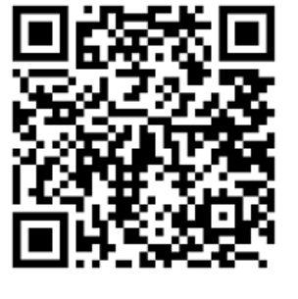


SET / sem
Target completion rate 50%
Strongly Agree = >
https://bluecastle-cn-surveys.nottingham.ac.uk
Neutral = >
Strongly Disagree = >

Slide 3
Exam Paper Format
75% Examination, 25% Coursework
4 Questions, each worth 25 marks
Exam duration 1.5 hours
Knowledge & Comprehension & Application
Lab content will not be included (NO CODE)

Slide 4
Past paper
Three past papers on Moodle page (2014, 2017,2020)
Similar Format
Solution won’t be provided!!!!

Slide 5
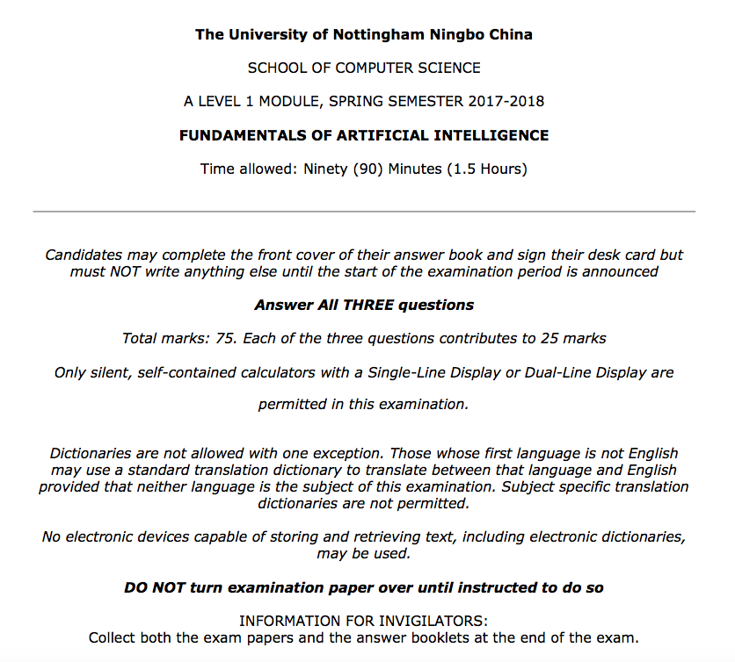

Slide 6
Part I: What to test
Knowledge/ Comprehension/ Application
AI basics and problem formulation
Search (uninformed, informed)
Game Playing

Slide 7
AI Basics
History of AI, definition of AI
Strong AI /Weak AI
Turing Test & Chinese Room
Basics in machine learning

Slide 8
Example Questions
[Comprehension] Briefly describe the Turing test and its objectives. Provide an example of a Turing Test in real life. Criticize Turing test by providing an example of objection. [7 Marks]
[Knowledge] In data mining, what are the relationships and difference between clustering and classification? [5 Marks]

Slide 9
problem FOMULATION & search tree
State Space
Manage a search tree to define a search problem
Evaluation criteria (Completeness, Time Complexity, Space Complexity, Optimality)
BFS, DFS, UCS, Greedy Search, A* Search
Heuristic function, Admissible, Informedness, Effective Branching Factor

Slide 10
Example Questions
[Knowledge and Comprehension] What does admissible mean? Why is it important that the heuristic used be admissible? How to evaluate two heuristic functions if both of them are admissible? [5 Marks]
[Comprehension and Application] Given the layout of 17 sticks shown in the figure, you are required to remove exactly 5 sticks in such a way that the remaining configuration forms exactly 3 squares. Given two different operators as shown below, calculate the corresponding size of the state space. [4 Marks]
Operator A: remove five sticks at a time.
Operator B: remove three squares at a time.

Slide 11
Game play
Components of Game Search
How is a game represented as a search problem?
Minimax Algorithm
Alpha-beta Pruning

Slide 12
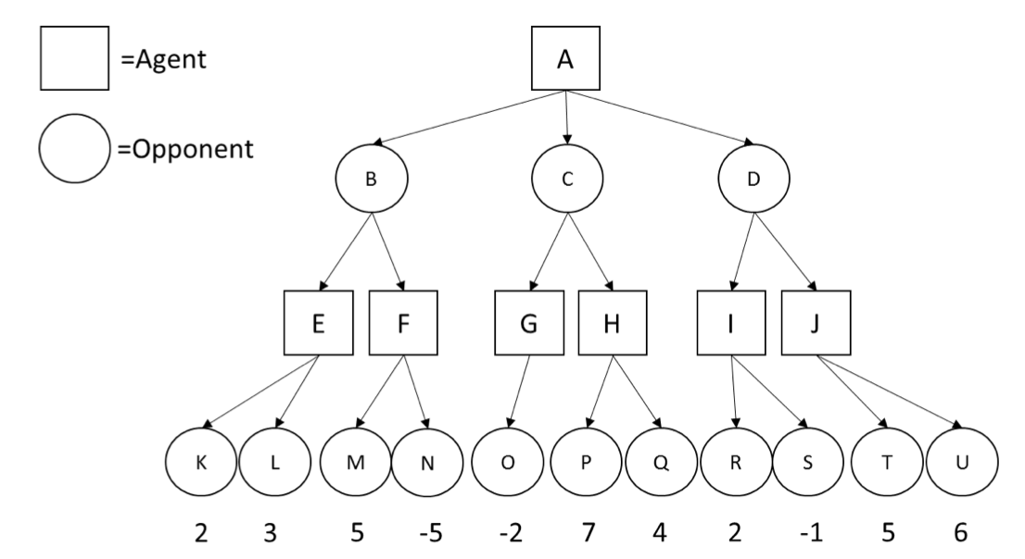
Example Questions
[Application] Given the following search tree, apply the alpha-beta pruning algorithm to it and show the search tree that would be built by this algorithm. Make sure that you show where the alpha and beta cuts are applied and which parts of the search tree are pruned as a result. Explain why the alpha and beta cuts occur. [8 Marks]

Slide 13
Outline
Machine learning
Markov Decision Process(MDP)
Supervised learning (Classification)
Unsupervised learning (Clustering )

Slide 14
Part II: What to test
Knowledge/ Comprehension/ Application
Supervised learning (Regression and Classification)
Unsupervised learning (Clustering )
Reinforcement learning (MDP)

Slide 15
Supervised learning
Basic concept of supervised learning
Concept of regression and classification
Basic idea of logistic regression and naïve bayes
Train a neural network (perceptron)

Slide 16
UnSupervised learning
Basic concept of Unsupervised learning
Clustering
K-means

Slide 17
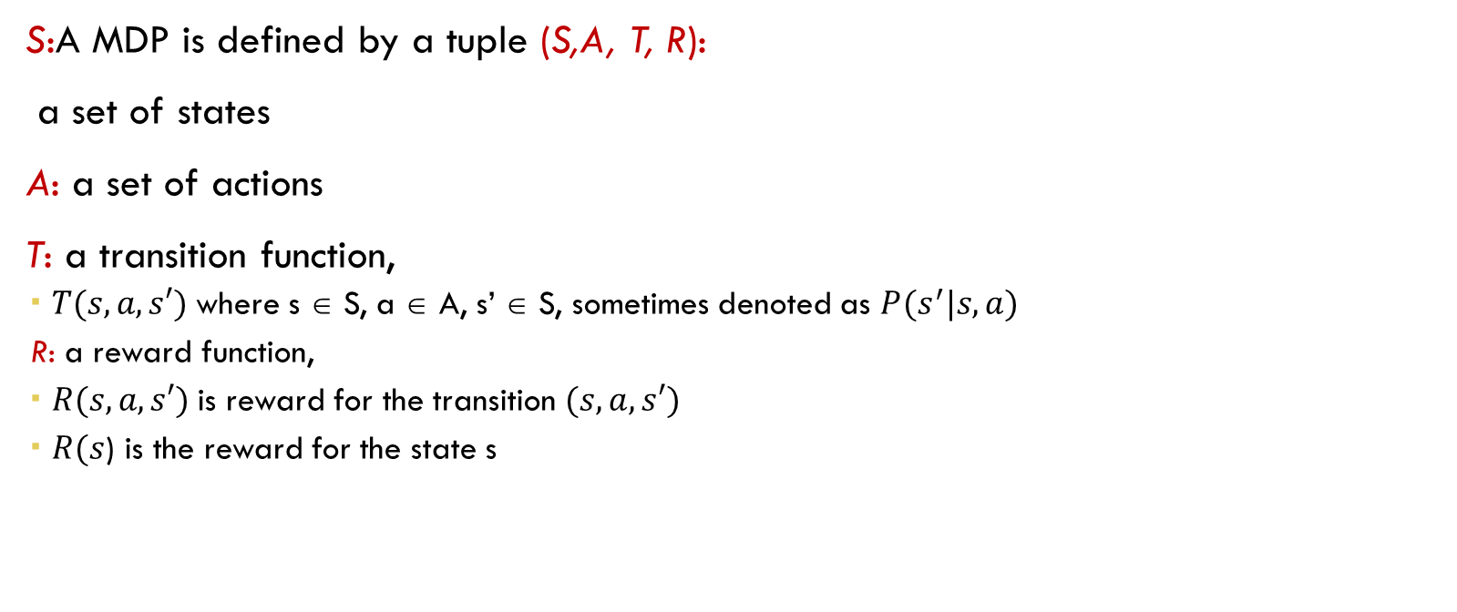
Markov Decision Process (MDP)
S:A MDP is defined by a tuple (S,A, T, R):
a set of states
A: a set of actions
T: a transition function,
$T(s,a,s′)$where s ∈ S, a ∈ A, s’ ∈ S, sometimes denoted as $P(s^{′}|s,a)$
R: a reward function,
$R(s,a,s′)$is reward for the transition $(s,a,s′)$
$R(s$) is the reward for the state s

Slide 18
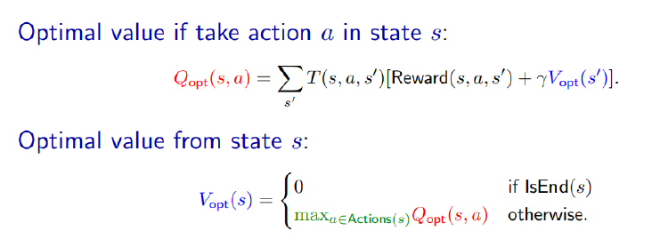
Markov Decision Process (MDP)
Bellman equation

Slide 19
Markov Decision Process (MDP)
Policy
Policy evaluation
Value iteration
Optimal value and optimal Policy
Bellman equation

Slide 20
Link to AI Method
Linear Programming, Integer Programming
Heuristic Algorithm
Metaheuristics(Genetic algorithm, Simulated annealing, Tabu search)
Population Based Metaheuristics
Hyper heuristic(Reinforcement learning)

Slide 21

GOOD LUCK !!!!!!

